Slide 1
Walmart Demand forecasting
@
EDA

Slide 2

Convo Framework to translate Business context into analytics problem
CoNVO Framework focuses on understanding the business requirement in more detail.
Four components define the CONVO framework – Context, Need, Vision and Outcome.
CONTEXT
NEED
VISION
OUTCOME
Forecast store sales for Walmart stores
Its wants to improve supply chain efficiency
1 Inventory turn over
2 reduce cost of goods sold
It wants to become lean organization
Forecasting engine

Slide 3
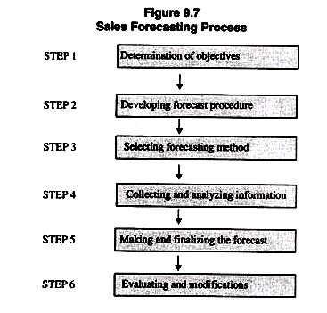
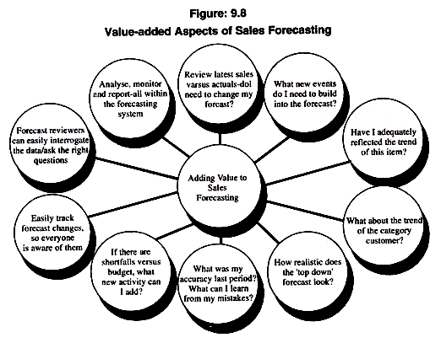

Slide 4
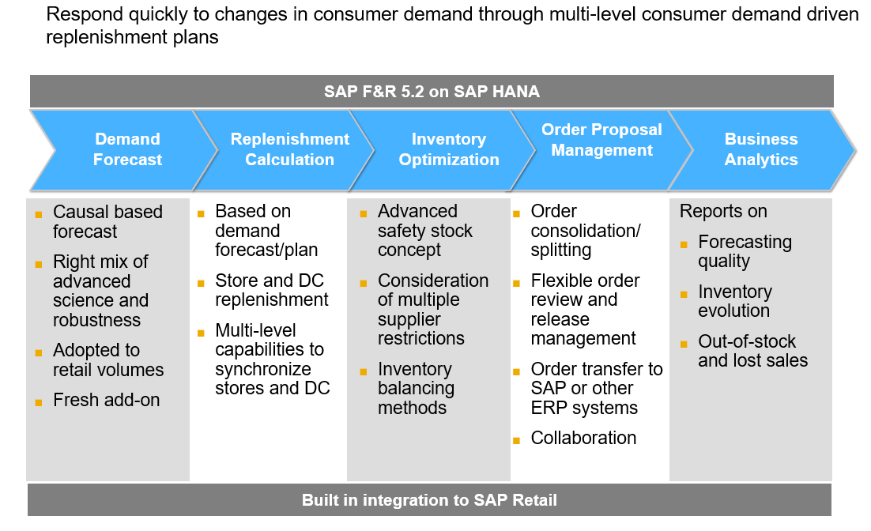

Slide 5
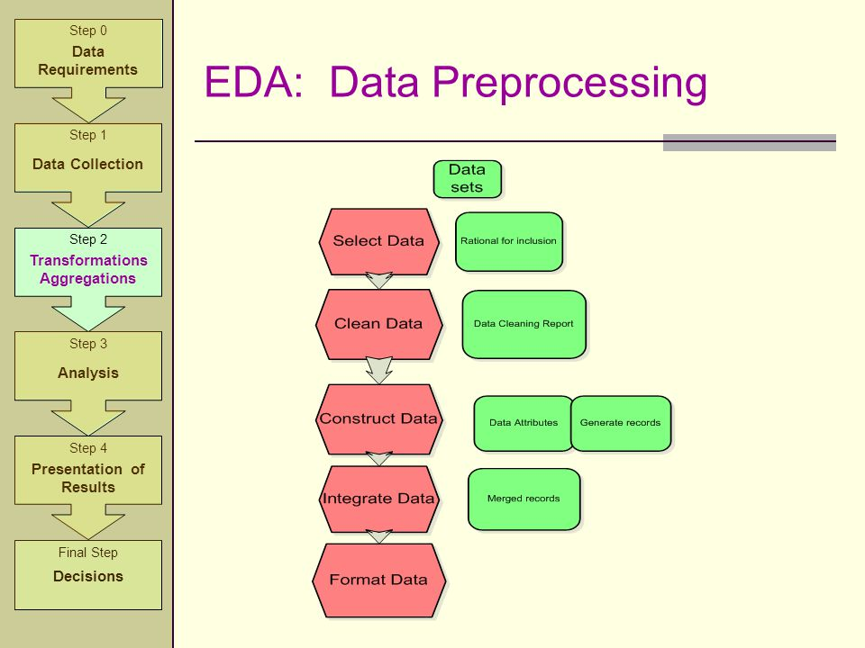
What is Data Preprocessing

Slide 6
Types of variables
1 Categorical
Ordinal
Nominal
2 Numerical(Date, Geographical etc)
3 Mixed

Slide 7
Problems in variables
Missing values
Outliers
Labels
Rare Values

Slide 8
Missing Value
Numeric
1 Mean Median Imputation
2 Random sampling Imputation
3 Adding a new variable to indicate missingness
4 Replace the variable by values at end of distribution
Categorical
1 frequency Imputation
2 Random sampling Imputation
3 Adding a new category as missing

Slide 9
Outliers
1 Top coding bottom coding Zero coding

Slide 10
Rare Values in Categorical variables
1 Replace the rare level by most frequent level
2 Grouping the observations that show rare labels into unique category
Decision Points
1 One Category
2 High cardinality
3 Low Cardinality

Slide 11
Engineering level in categorical variables
1 One hot Encoding
2 One hot Encoding with many levels
3 Ordinal Number coding
4 count of frequency encoding
5 Target guided ordinal encoding
6 Mean encoding
7 WOE

Slide 12
Feature Engineering/Transformation
Mixed Variables
Dates
Numeric Variables
Categorical Variables

Slide 13
Feature Scaling
Min Max Scaling
Box cox Transformation

Slide 14
Discretization
Equal frequency
Equal width
Domain knowledge
Decision tress

Slide 15
EDA
Pair plot
Line Plot
Correlation

Slide 16
